Slide 1
OpenShift Demo
How to get Heating Temperatures into the Cloud
Hendrik Wagner (hwagner1@de.ibm.com)
Oct 2020

Slide 2
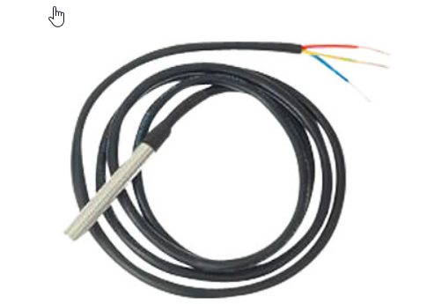
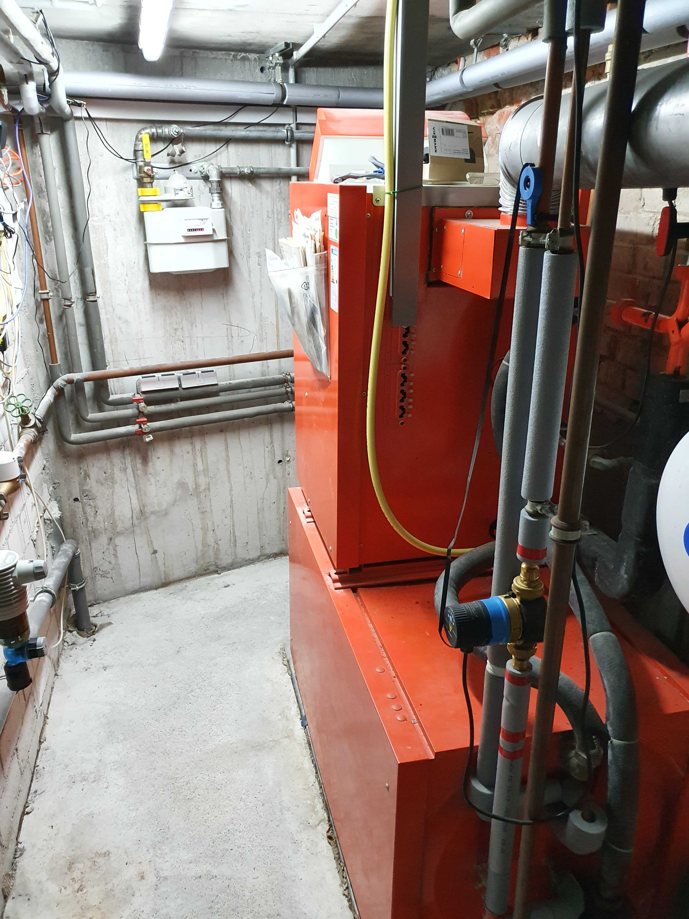
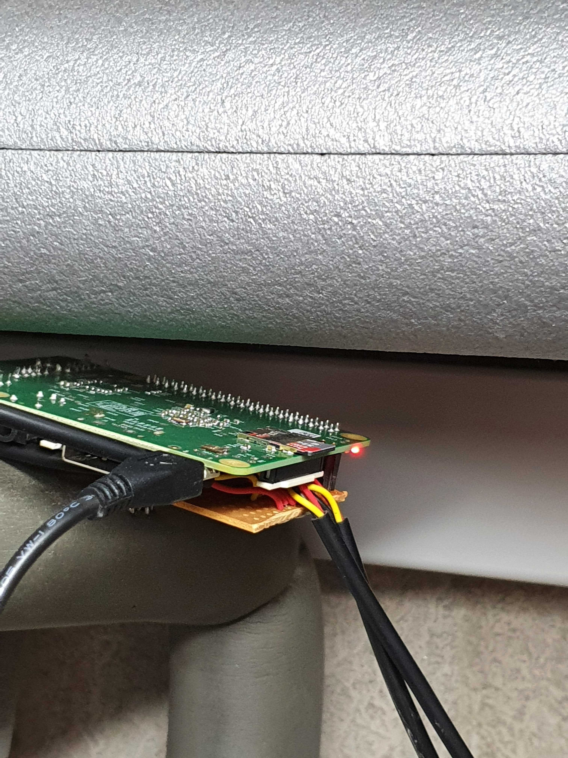

My Heating Room
Measuring four temperatures
with I2C Thermo Sensors
Warm water
Circulation
Heating pipe out
Heating pipe in
Raspberry Pi

Slide 3
Problem Statement
I want to see the 4 temperatures in a nice dashboard on my mobile or any other device
Requirement: No access from internet to my home

Slide 4

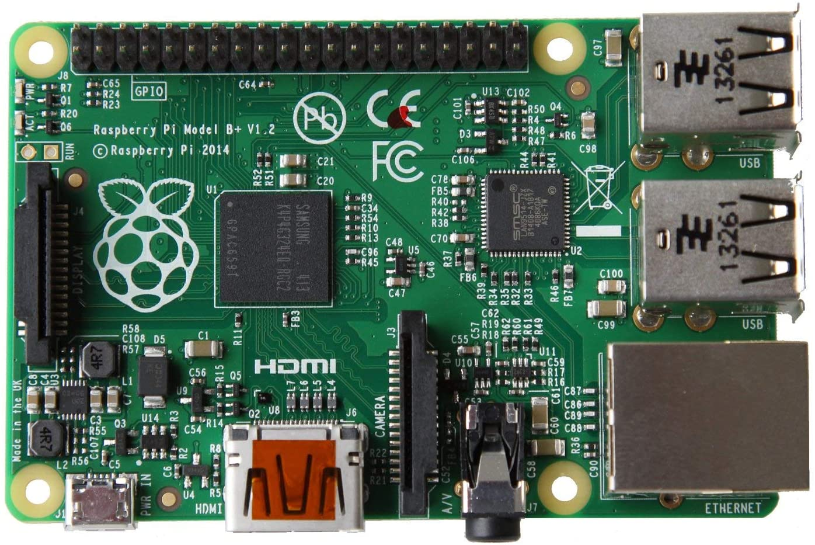





Solution Overview
Internet
IBM Cloud
Raspberry Pi
OpenShift 4
Cluster
http POST
http GET
http GET
Http-Server
Prometheus
Me

Slide 5
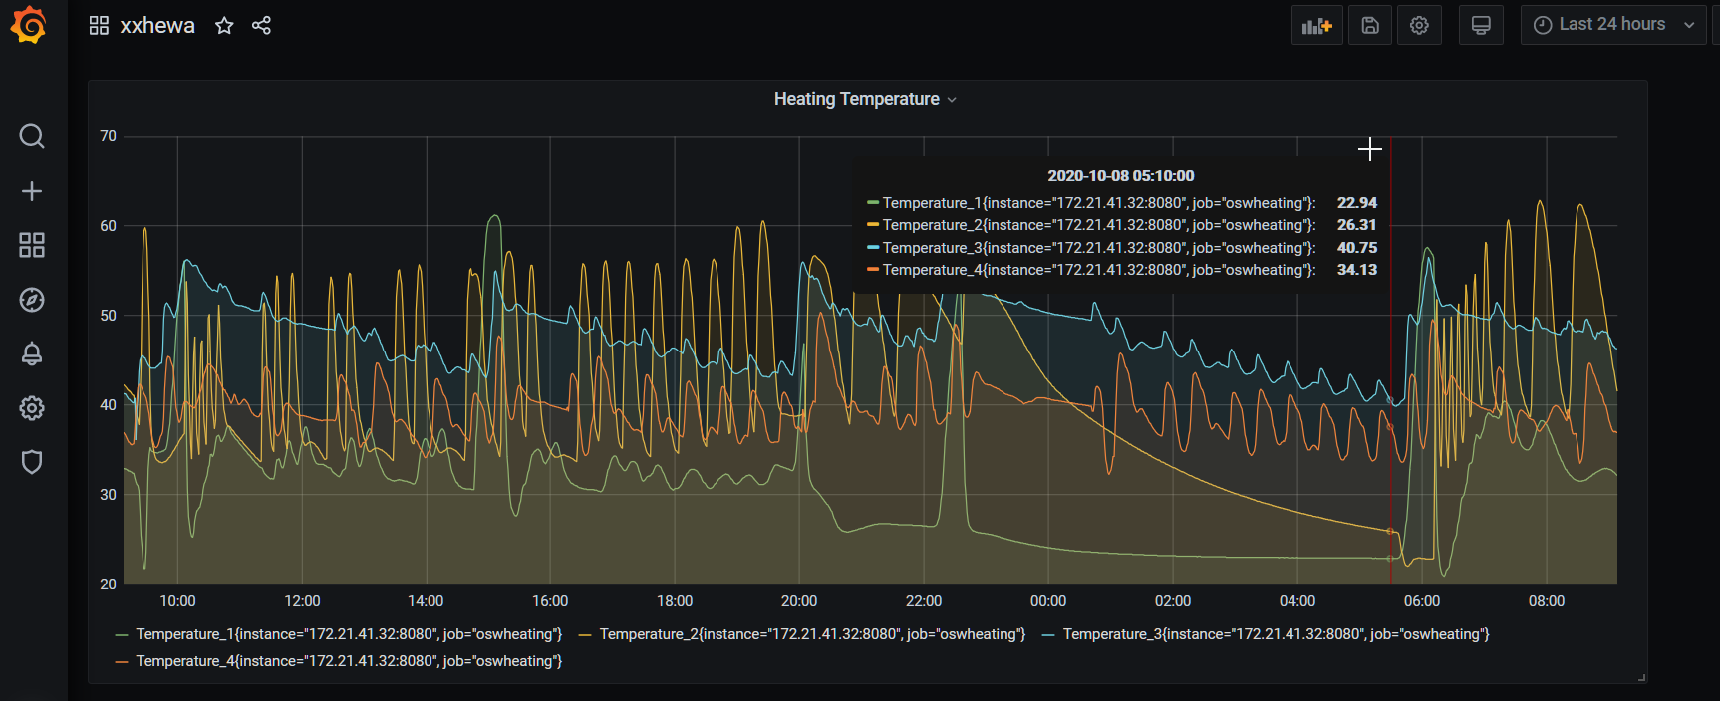
Sample Dashboard

Slide 6
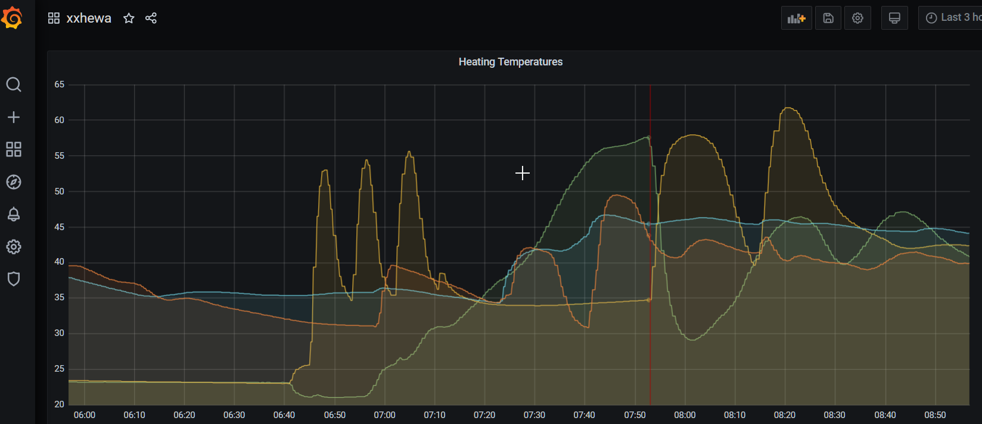
Sample Dashboard

Slide 7
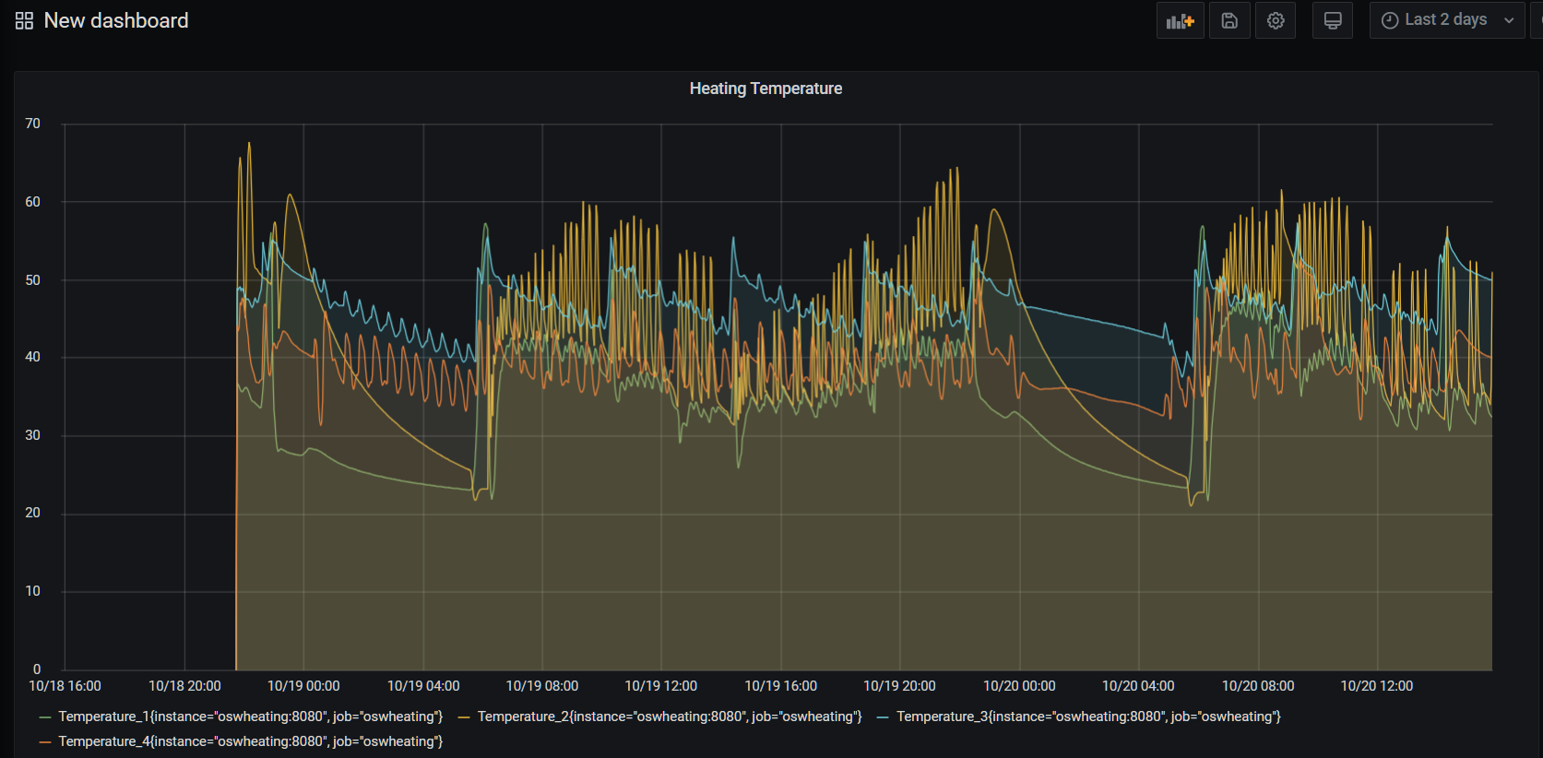
Sample Dashboard

